Slide 1
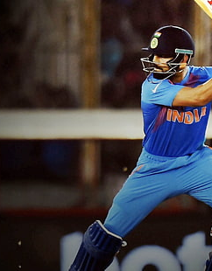
Analysis of T-20 world cup 2022
Kushagra Panjwani​

Slide 2
Work FLow
1
2
3
4
5
Descriptive Statics
Introduction
Data summary
Data Cleaning
Visualizations and conclusions

Slide 3

Introduction
As we know , Each sporting occasion yields copious amounts of data, offering valuable insights into player and team performance as well as key moments of the game. So , in the following notebook we have tried ti analyze T-20 men's world cup data and tried to get meaningful insights out of it.
The dataset was provided to us in the problem statement.
The dataset provided to us was very big and had 10000 rows , so i have summarized the data into summary.csv to make analysis easier

Slide 4
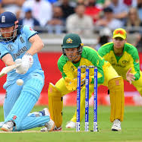
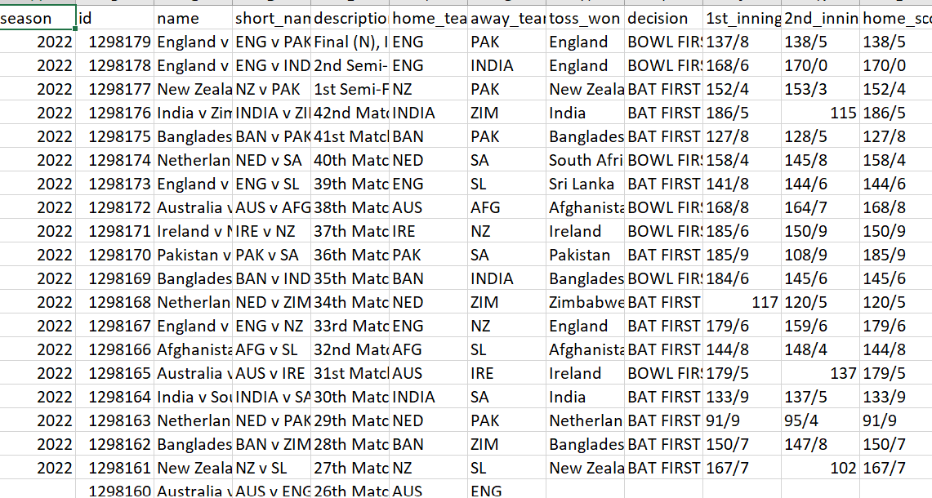
Summarizing of data
The Dataset provided was very huge and difficult to analyze so it has been concise and important aspects of that data have been added.

Slide 5
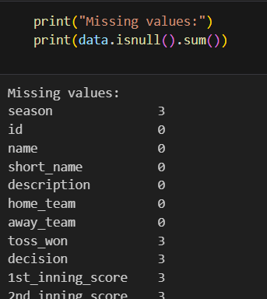
Data cleaning
This steps involves cleaning of data
Since 3 matches were abandoned due to rain, these 3 entries must be removed from the data to make further analysis.
So this is done in the code.

Slide 6
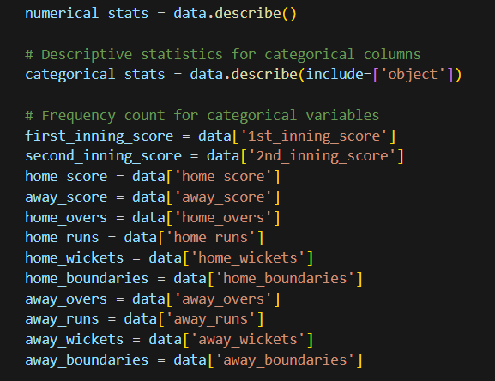
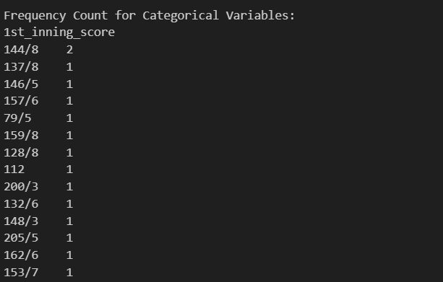
Descriptive Statistics
This Step involves analysing the overall data
Mean of wicket taken , Bowls bowled , runs made etc are calculated
This step clearly helped in analysing the average statistics of the match.

Slide 7
Graphical Visualizations Helps in much better analysis then written data
“
Visualizations
”
R

Slide 8
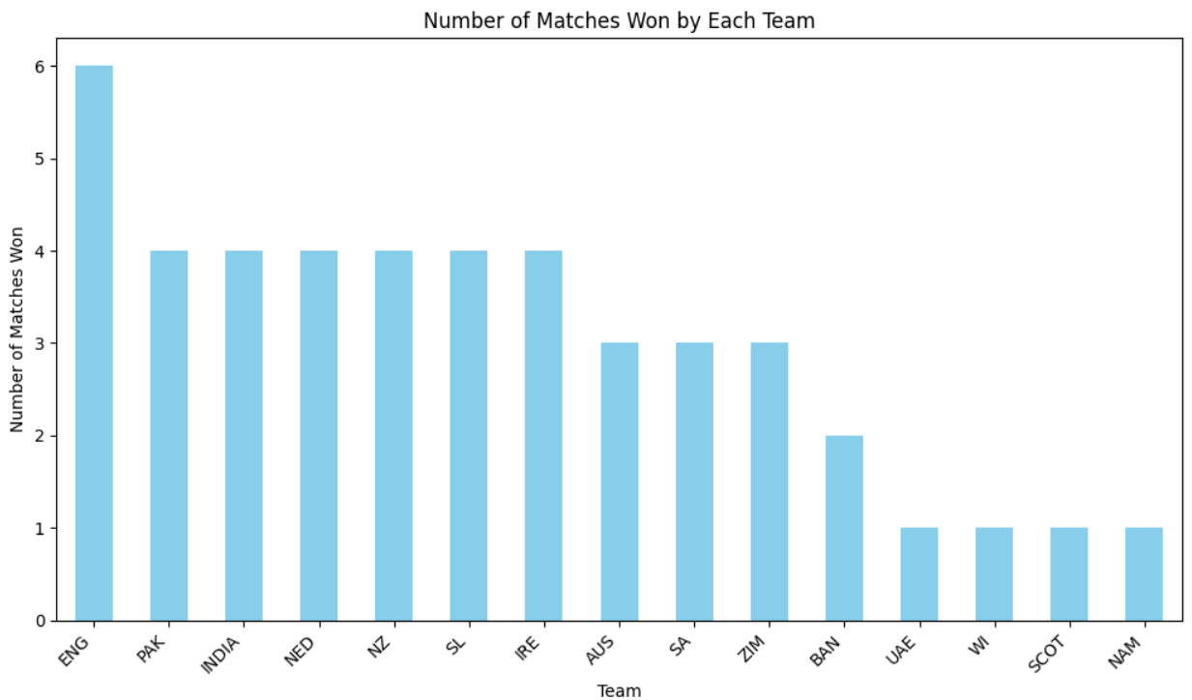
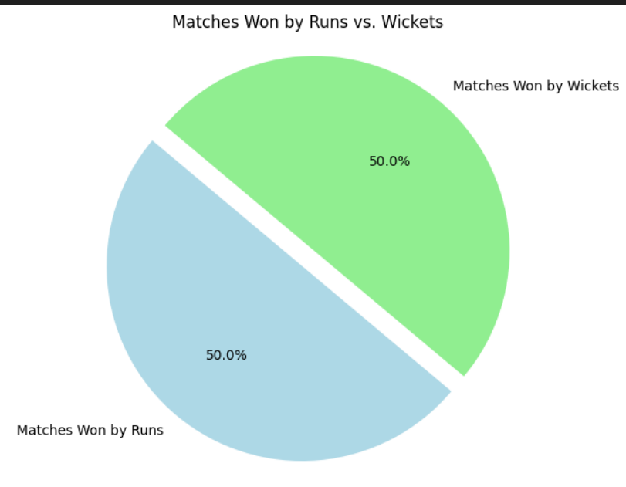
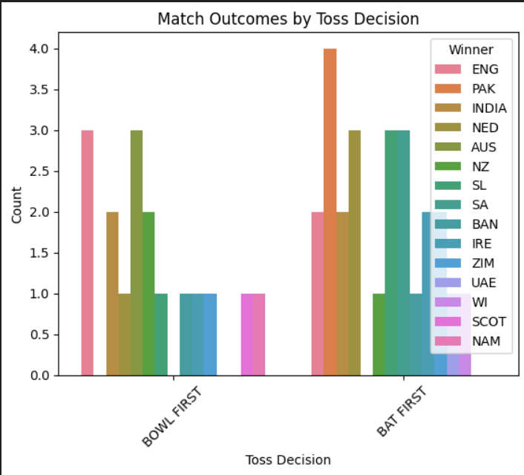




Different Visualizations
Takuma Hayashi
Mirjam Nilsson
Flora Berggren
Rajesh Santoshi
President
Chief Executive Officer
Chief Operations Officer
VP Marketing

Slide 9
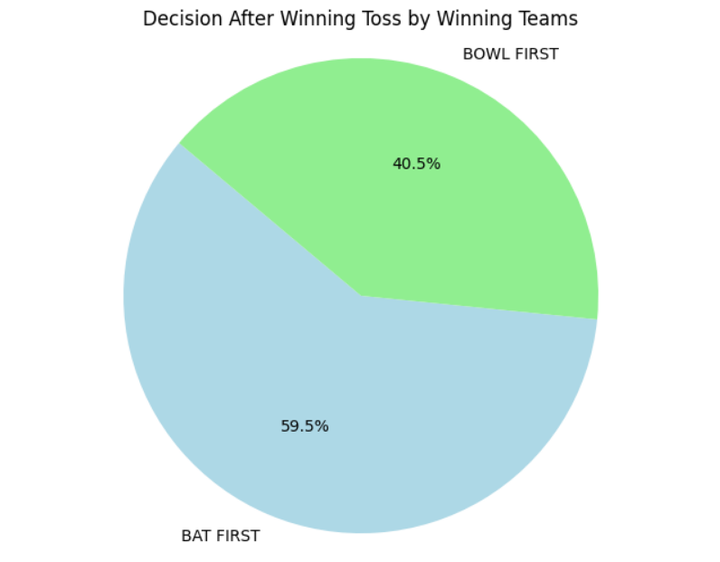
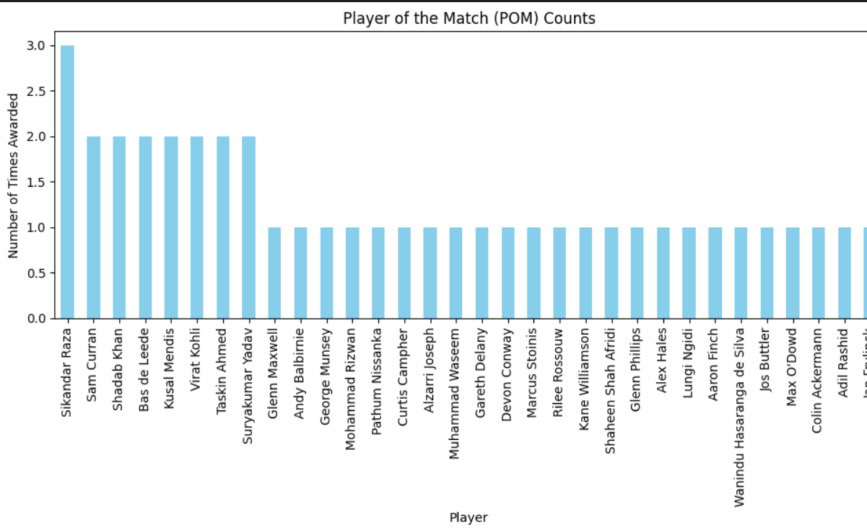








Visualizations
Takuma Hayashi
Mirjam Nilsson
Flora Berggren
Rajesh Santoshi
President
Chief Executive Officer
Chief Operations Officer
VP Marketing
Graham Barnes
Rowan Murphy
Elizabeth Moore
Robin Kline
VP Product
SEO Strategist
Product Designer
Content Developer

Slide 10
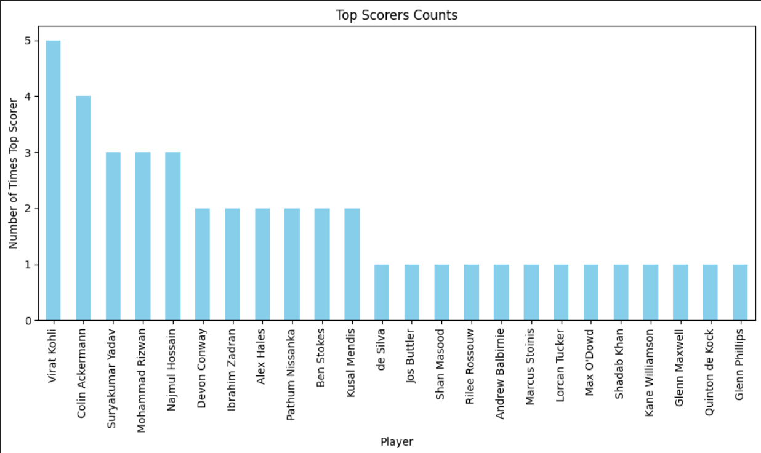
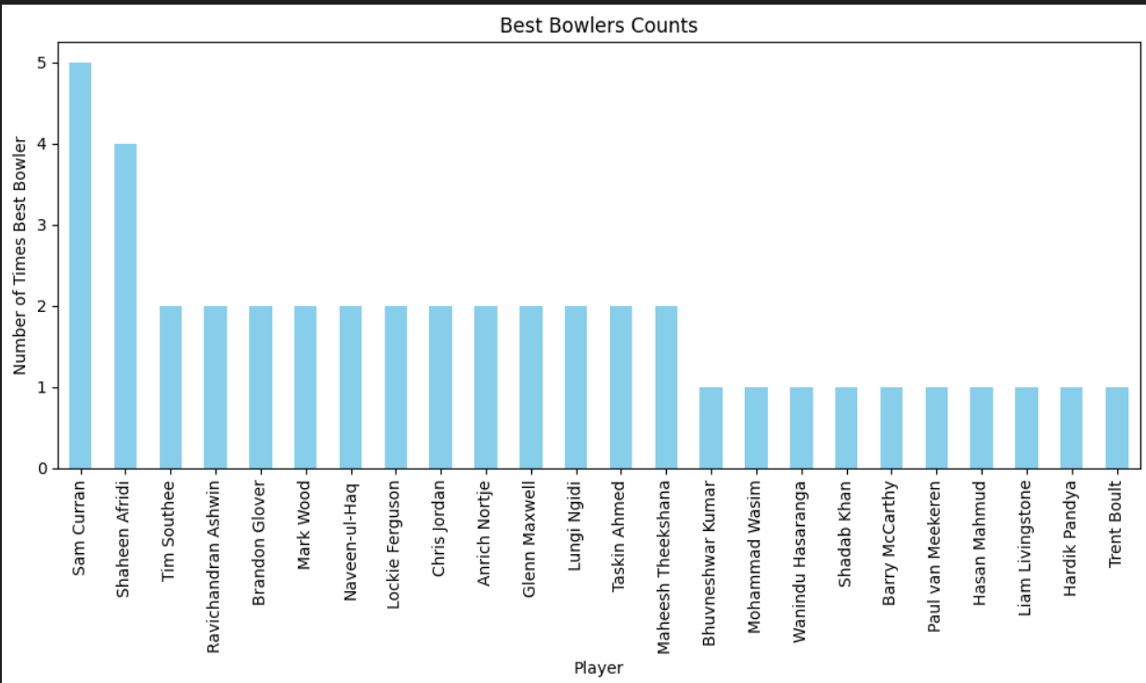
Visualizations
Takuma Hayashi
Mirjam Nilsson
Flora Berggren
Rajesh Santoshi
President
Chief Executive Officer
Chief Operations Officer
VP Marketing
Graham Barnes
Rowan Murphy
Elizabeth Moore
Robin Kline
VP Product
SEO Strategist
Product Designer
Content Developer

Slide 11
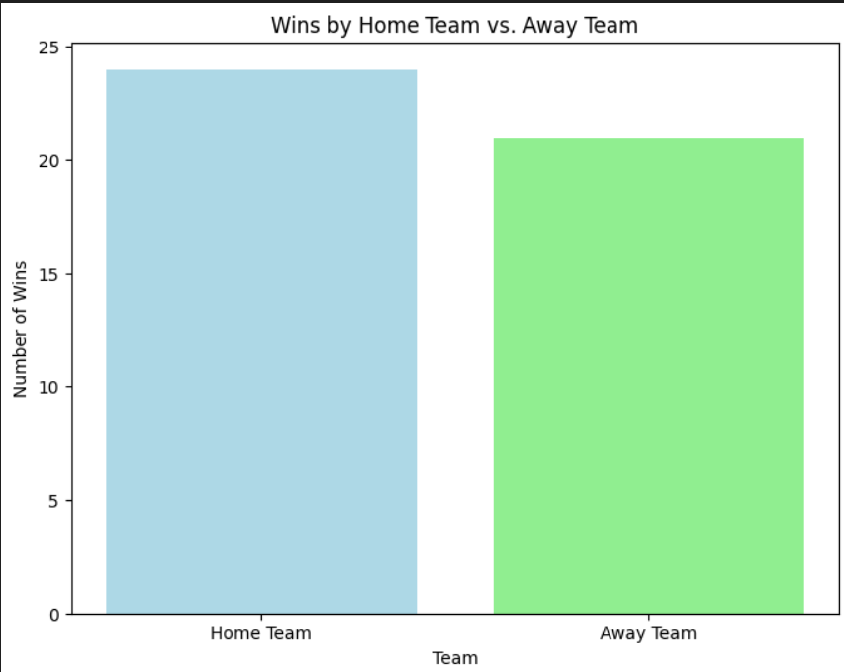
Summary
Home team always had an advantage
England won the most number of matches
Virat Kohli scored highest in the most number of matches
Sam Curran was the best bowler in the most number of matches
More teams won by batting first
More teams decided to bat first
Bat vs Bowl wins tend to be almost equal

Slide 12
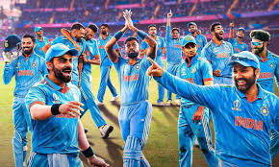

Thank you
Kusharga Panjwani

